Slide 1

Intellectual Property Rights
and Constitutional Values – What’s at Stake for the Stakeholder
Intellectual Property Rights and Constitutional Values Study Group
Grant-in-Aid for Scientific Research
February 23, 2017
This document is the property of the MPA and contains sensitive data that should not be distributed without written consent from the MPA
本資料は、MPAA/MPA及びそのメンバー社以外に配布すべきでない機密データが含まれています。
Notes:
I appreciate this opportunity to have this discussion with you today. I would like to note that while I have been working on IP issues and protecting authors and creators for 20 years, I am not a Japan trained lawyer. Nonetheless, looking at the issues, the presentation presents our views on Constituional issues in the hope you may take our view on and will be convinced that it is right. I would note that I have taught at George Washington University Law School for 12 years.

Slide 2

The Copyright Seesaw Out of Balance
© Mihály Ficsor. Used with permission of the author.
The copyright “balance” or “seesaw” which the Universal Declaration of Human Rights guarantees in Article 27(2), expressed as the right of “Everyone” to “the protection of the moral and material interests resulting from any scientific, literary or artistic production of which he is the author,” is off-kilter:
  Increasingly, piracy websites profit off the infringement of copyright in valuable creative content – motion pictures, television programming, music, games, software, and other copyright materials – and stifle the legitimate creative marketplace for local and foreign creators alike.
  Use of infringing websites represents a drain on the legitimate digital economy, and represents a shockingly large percentage of all Internet traffic – an estimated 23.8% of all Internet bandwidth in North America, Europe, and the Asia-Pacific based on publicly-available information. This is a hindrance to important creative expressions/speech.

Slide 3
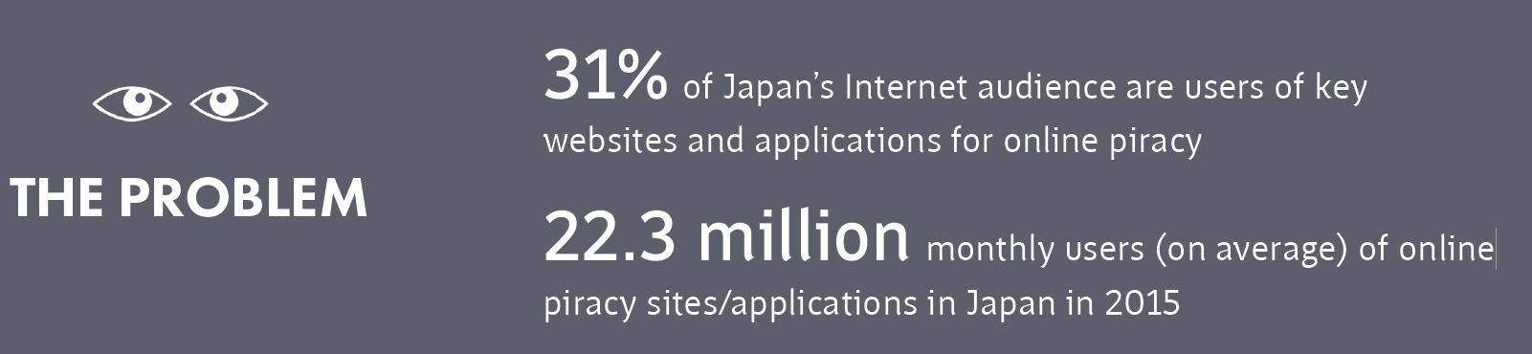
Japan’s Piracy Landscape
In a three month period in Japan, there were
94,842,090 Local Pirate Visits and 566,923,178 Local Pirate Page Views
Local visits at pirate sites are 1.63 times higher than at legitimate sites
Local page views at pirated sites are 1.13 times higher than at legitimate sites
The source of illegal content with Japanese subtitles is almost 100% from overseas sites.

Slide 4
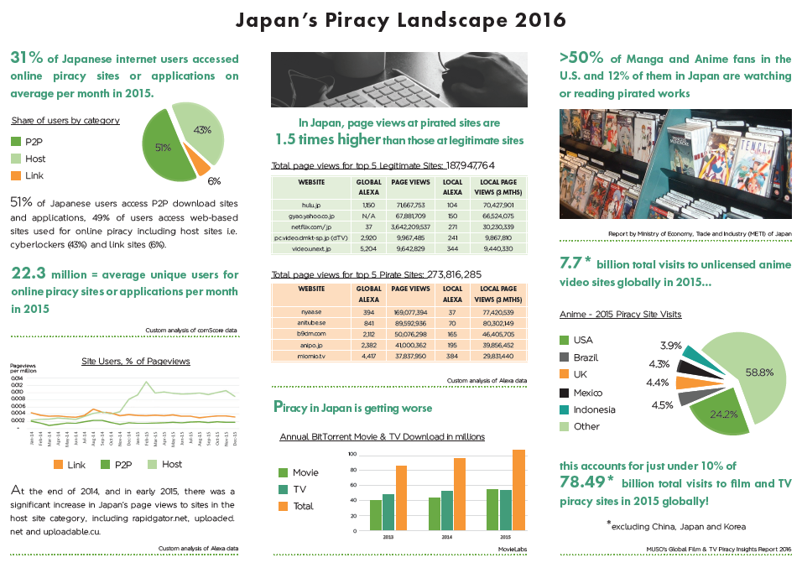
Japan’s Piracy Landscape

Slide 5
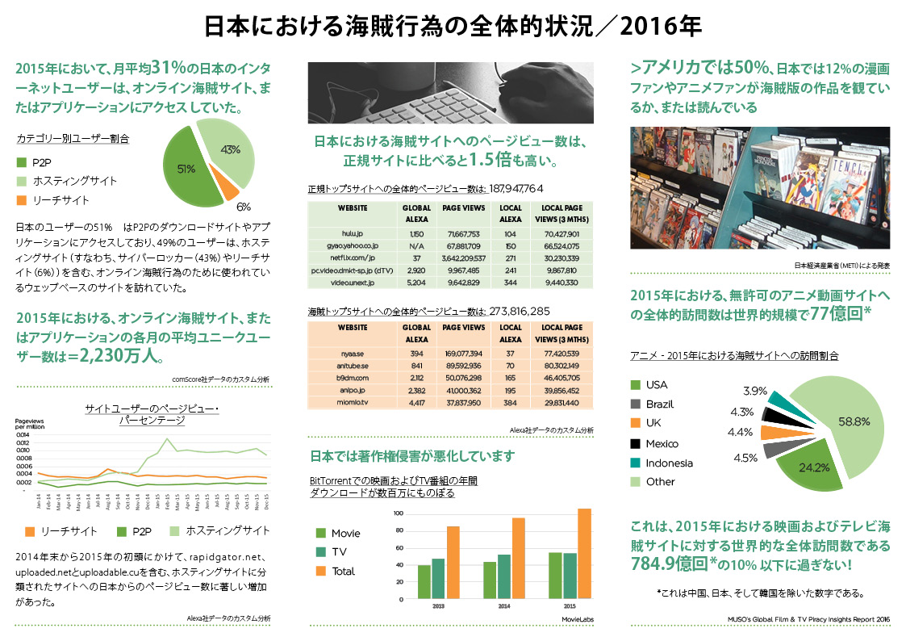

Slide 6
Emergence of Site Blocking as an Effective Solution
As a result of this imbalance, over the past few years, governments have attempted to find solutions to combat the proliferation of websites engaging in online copyright infringement.
One of several solutions, site blocking, has proven a powerful and effective tool to combat piracy, and has also been shown to result in past users of piracy seeking legitimate offerings.
However, some argue that site blocking may also raise certain Constitutional issues in Japan.

Slide 7
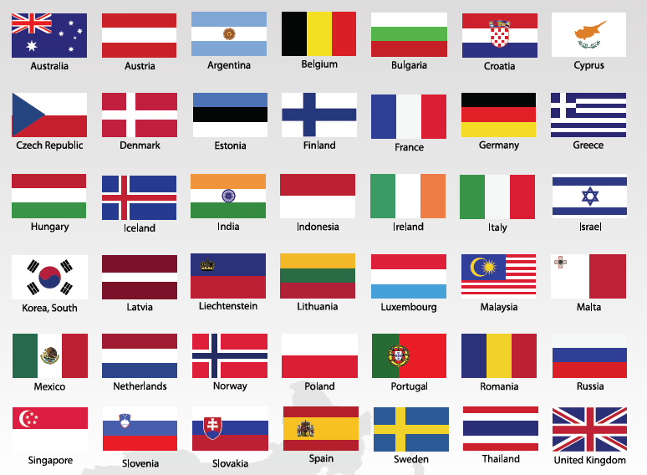
Countries with Site Blocking (42 Countries Including EU!)

Slide 8
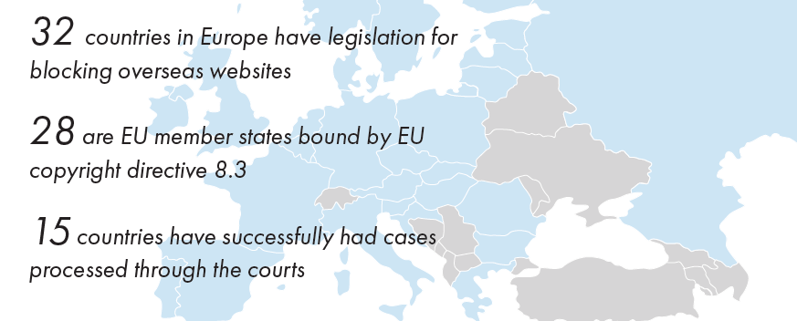
Site Blocking in Europe

Slide 9
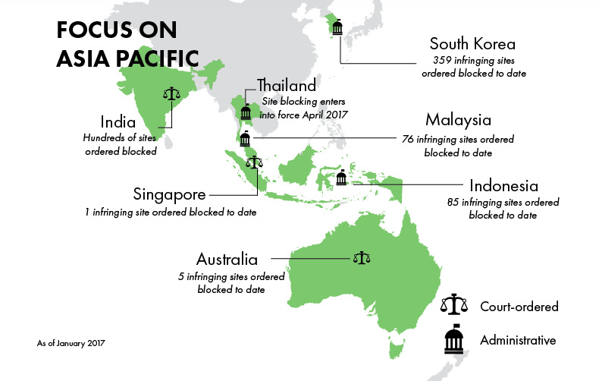
Site Blocking in Asia Pacific an Emerging Best Practice

Slide 10
Constitutional (or Other Fundamental) Issues When Considering Site Blocking (Japan and Select Others)
Proportionality (e.g., Article 5 of the Treaty on European Union) (EU finds time and again, yes, it’s proportional).
  Free Expression and Speech (Japanese Constitution Article 21(1)) (no conflict; piracy, like other illegal communications, e.g., child pornography, can be limited).
Privacy
  Japanese Constitution Article 21(2)
  Telecommunications Business Act (TBA) Article 4 on “Protection of Secrecy”
  E.g., Article 7 of the EU Charter of Fundamental Rights
Notes:
Article 4 (Protection of Secrecy)
(1) The secrecy of communications being handled by a telecommunications carrier shall not be violated.
(2) Any person who is engaged in a telecommunications business shall not disclose secrets obtained, while in office, with respect to communications being handled by a telecommunications carrier. The same shall apply even after he/she has left the office.

Slide 11
Website Blocking Process and Privacy
The view espoused by some that website blocking may violate the TBA or Japanese Constitution is incorrect and demonstrates a misunderstanding about the way the Internet functions.
ISPs do not acquire private information about communications they handle, whether website blocking occurs or not.
It should be noted that ISPs already engage in website blocking to remove access to some kinds of illegal activity.

Slide 12




How an Internet Request Works
Step 1
Step 2
User wants to browse website 123.com
User key-in www.123.com in web browser
Domain Name Server translates Domain Name into Internet Protocol
Step 3
ISP asks Domain Name Server (DNS) to find www.123.com
Domain Name Server
Step 4
Browser finds www.123.com at web server
Web server of 123.com
Webpage data sent back to user’s browser
12

Slide 13
How an Internet Request Works
When a user keys in a domain name (e.g., www.abc123xyz.com) or exact Internet location (e.g., www.abc123xyz.com/exactlocation, called a URL) on an Internet browser, usually, the browser asks something called the Domain Name Server of an ISP (which contains a database that maps the domain name to its corresponding IP address) to go to that domain or URL.

Slide 14
How an Internet Request Works
Once the Domain Name Server finds the IP address for the website, the ISP will then return the IP address to the user’s computer or browser, upon which the browser will use the IP address to establish a connection with the website, enabling the user to access the content.

Slide 15
How an Internet Request Works
If an ISP disables access to a domain, the ISP will automate the disablement from its end, like setting up a roadblock, and the user, when requesting the desired domain name or URL, will receive nothing back (or, like the roadblock, will reach the roadblock, and not be able to travel further).

Slide 16
How an Internet Request Works
The sequence is that the ISP will already have effectuated the action disabling the domain (or in the case of the roadblock, it will already be in place but no one is watching or gathering information about the kind of car, who drives it, the license plate number, etc.), so the ISP has no knowledge of the user’s action.

Slide 17
How an Internet Request Works
The ISP does not have knowledge of user information, such as what specific content they are seeking, the date or time of their request, or any personally identifiable information in the case of a blocked site nor an unblocked site.

Slide 18
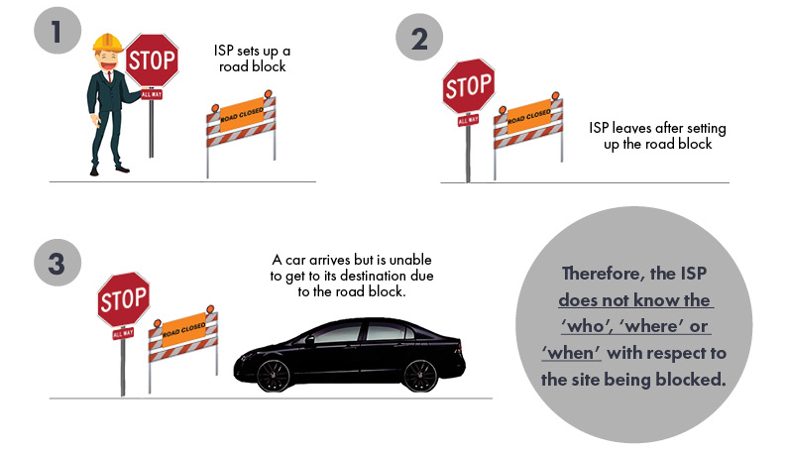
Site Blocking Does Not Violate The Constitution or TBA

Slide 19
Internet Usage Data is By Its Nature Public
It is useful to note here that Domain Name System information, which would include users’ requests for specific domains or IP addresses, is by its nature public.
This is why there are hundreds if not thousands of services available, including website traffic services like Alexa and SimilarWeb, that are able to obtain statistical traffic data on all Internet websites.
Internet communications are knowable whether website blocking has occurred or not.
As long as an ISP does not take active steps to learn such information, it will not run afoul of the TBA.
Thus, it is erroneous to conclude that site blocking per se violates the TBA.

Slide 20
Understanding Internet Communications in Modern Context
The Japanese Constitution was enacted approximately 70 years ago and the Telecommunications Business Act was enacted approximately 30 years ago; and both presuppose traditional methods of communication such as personal letters and telegrams.
Accordingly, in the modern age when information distribution using the Internet has become mainstream, application of the original interpretation of these regulations is not appropriate.
Domain Name System information may be accessed by the public, and connection to a public website on the Internet is by its nature considered as a “publicly open communication.”

Slide 21
Scholars and Government Coming Around on this Issue
Consider the view that information posted on online bulletin boards and websites with knowledge (or constructive knowledge) that it will be shown to unspecified users shall be understood as information in which the sender has no intention of maintaining confidence, and therefore excluded from consideration as a private communication. Kazuteru Tagaya, “Annotations to the Telecommunications Business Act,” p38 (2008, Denkitsushin Shinkokai).
There is also a basic mindset that held in Japan that a certain level of content restriction may be imposed on “publicly open communication.” Ministry of Internal Affairs and Communications, “Report of Study Group on Comprehensive Legal System of Communication and Broadcasting” (December 6, 2007).
There is also the view that the scope of protection for a confidential communication should be limited to its contents, and points such as which site was accessed and who contacted who should be considered beyond the scope of “confidential” information under the Constitution and the TBA. Joji Shishido, “Confidence of Communication,” p 24.

Slide 22
Privacy and Site Blocking: The European Perspective
Germany’s Federal Constitutional Court (BGH) in late 2015, confirmed in the case of GEMA v Deutsche Telekom that site blocking does not breach privacy rights under German or EU law.
In analyzing whether site blocking can be consistent with Article 10 (1) of the German Constitution (right of privacy of telecommunications), the Court noted, “[t]he starting point for the protection in Art. 10 (1) … is always the non-public exchange of specific communications of participants; in contrast, communications addressed to the general public are not covered by this provision.”
The Court then found that “a site providing links to downloads on the internet directed at an unspecific number of addressees does not constitute confidential individual communication rather it is, as a public offering, not covered by the scope of protection of Art. 10 (1) ….”

Slide 23
Privacy and Site Blocking: The European Perspective
Importantly, the Court also concluded that DNS blocking “does not affect the confidentiality of communication protected under Art. 10 (1) ….”
The Court was emphatic about DNS blocking’s conformity with the German Constitution, noting DNS blocks are inherently unproblematic as the establishment of connections is simply prevented – without access to IP addresses of users.

Slide 24
Site Blocking Does Not Violate The Constitution or TBA
24

Slide 25
Privacy and Site Blocking: The European Perspective
According to the Court, offering files for public download and accessing those files does not constitute an individual communication protected by Article 10 of the German Constitution.
“The fact that access to a public offer of a download occurs in each case through means of individual technical communications connections does not justify a classification as communication within the meaning of Art. 10 (1) German Constitution, because a mere technical communication does not exhibit the specific risks for the privacy of the communication which that provision protects …. Such access actually constitutes a public form of communication comparable to the use of mass media ….”

Slide 26
Privacy and Site Blocking: The European Perspective
Importantly, addressing one of the key objections raised in respect of site blocking in Japan, the German Court further concluded, “the (automated) obtaining of knowledge, on the part of the provider, of the circumstances of communication is limited to that necessary to interrupt the communication.”
Notes:
Emphasize that “knowledge” is the “what” is being blocked, not information about the user.

Slide 27
Privacy and Site Blocking: The European Perspective
The German Court also found that site blocking does not breach Article 7 of the EU Charter of Fundamental Rights, since the purpose of the right – protecting “the confidentiality of communication which is directed at particular addressees and not at the public – is not affected by the blocking of public offerings of downloads or access to them.”

Slide 28
Privacy and Site Blocking: The European Perspective
The reasoning in the German decision is consistent with decisions throughout the European Union, since the same considerations apply to balancing the rights of authors (and their enforcement needs) against the fundamental right of privacy, ensuring that there is proportionality.
Interestingly, no other court in an EU jurisdiction has, to our knowledge, felt the need to examine in detail these questions, viewing website blocking as an appropriate remedy that is not inconsistent with privacy rights.

Slide 29
Is Site Blocking Effective?
Reviewing the impacts of website blocking efforts in other countries aimed at online IP infringement reveals its practicality and effectiveness in combating sites that flagrantly infringe copyright and whose operators show a blatant disregard for the rights of authors and creators.

Slide 30
SITE BLOCKING PROVED EFFECTIVE IN REDUCING TRAFFIC TO PIRATE SITES IN INCOPRO’S UK STUDY (Nov 2015)
77% Average Fall In Traffic From The UK To Blocked Piracy Sites
33.5% Average Global Traffic Decline To Blocked Piracy Sites
25% Overall Traffic Decline To The Top 250 Piracy Sites From The UK, Including Those Not The Subject Of Blocking Orders
6.6% Overall Global Traffic Decline To The Top 250 Piracy Sites From The UK, Including Those Not The Subject Of Blocking Orders
30
Site Blocking Efficacy Study UK, Incopro, ^{Revised May 2015}

Slide 31
CMU Research (May 2015):
Injunctions Increase Traffic To Legal Sources Of Content
In May 2015, Another Study From The Carnegie Mellon University Suggests That
Website Blocking Requires Persistent Blocking Of A Number Of Piracy Sites In Order To Effectively Migrate Pirates To Legal Channels
23%
Increase In Usage Of Legal Streaming Services (Such As Netflix) Among The Heaviest Users Of The Major Piracy Sites Blocked In The UK
31
The Effect of Piracy Website Blocking on Consumer Behavior, Carnegie Mellon University

Slide 32
CMU Research (Apr 2016):
Injunctions Increase Traffic To Legal Sources Of Content
In Apr 2016, An Updated Study From The Carnegie Mellon University Suggests That
Blocking Large Numbers Of Sites (53) in the UK in Late 2014 Moved The Needle In Terms Of Consumer Behavior…Such Blocks Reduced Piracy Significantly and Drove Consumers to Legitimate Offerings.
90%
Decrease In Visits To Blocked Piracy Sites While Causing No Increase In Usage of Unblocked Piracy Sites
6%
Increase In Visits To Paid Legal Streaming Sites Like Netflix
10%
Increase In Videos Viewed On Legal Ad-supported Streaming Sites Like BBC and Channel 5
22%
Decrease In Total Piracy For All Users Affected By The Blocks
Brett Danaher et al, Website Blocking Revisited: The Effect of the UK November 2014 Blocks on Consumer Behavior (April 2016), http://ssrn.com/abstract=2766795.
32
Notes:
Carnegie Mellon University (CMU), researchers found that blocking 53 piracy websites in the UK in November 2014 caused a 90% drop in visits to the blocked piracy sites while causing no increase in usage of unblocked piracy sites.
This led to a 22% decrease in total piracy for all users affected by the blocks.
These blocks caused a 6% increase in visits to paid legal streaming sites like Netflix.
Significantly, these blocks also caused a 10% increase in videos viewed on legal ad-supported streaming sites like the BBC and Channel 5.
Brett Danaher et al, Website Blocking Revisited: The Effect of the UK November 2014 Blocks on Consumer Behavior (April 2016), http://ssrn.com/abstract=2766795.

Slide 33

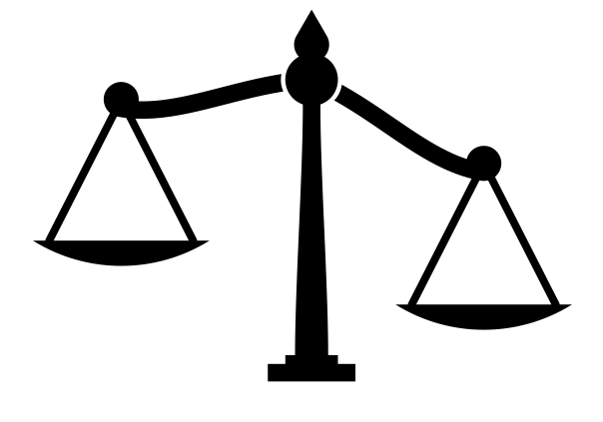
CMU Research (DEC 2015)
Without Piracy, Box-office Revenue Would Have Been
15% HIGHER PER YEAR
The Promotional Effect Of Piracy Did Increase Box-office Revenue By An Average Of 1.5%
But The Promotional Impact Of Piracy Is
Far Outweighed By The Cannibalization Effect
33
The Dual Impact of Movie Piracy on Box-Office Revenue: Cannibalization and Promotion, ^{Carnegie Mellon University}

Slide 34


If We Can Completely Block Infringing Websites In
Then The Additional Revenue To Her B.O. In 2015 Would Be
JAPAN
¥30 billion
This Represents 15% Increase In B.O. Revenue
In A Year
Recent Research By The Carnegie Mellon University Supports This
34
The Dual Impact of Movie Piracy on Box-Office Revenue: Cannibalization and Promotion, ^{Carnegie Mellon University}
Notes:
1793.9 million 2015 Japan BO

Slide 35
Is Site Blocking Effective?
In Portugal, researchers studied the effects of website blocking for two sets of websites (Group A and Group B).
Site blocking in Portugal resulted in a 75.5% drop in usage three months after implementation of blocks for the sites in Group A, and those in Group B showed a total usage decrease of 60.1% after two months.
In addition, overall usage of the top 250 piracy websites decreased by 23.4% in Portugal during the same period, even while it increased by 4.9% globally.
Incopro, Site Blocking Efficacy in Portugal September 2015 to February 2016 (May 2016).

Slide 36
Is Site Blocking Effective?
Visits to blocked sites in South Korea declined on average 90% as of three months after a block.
There was a 15% decrease in total piracy visits after three rounds of website blocking.
As website blocking in South Korea was heavily concentrated on P2P sites, it is noteworthy that overall visits to P2P sites (not just those sites blocked) showed a 51% decline as of three months after the three rounds of website blocking.
Motion Picture Association, MPA Study on Site Blocking Impact in South Korea (2016).

Slide 37
Three Key Takeaways
Site blocking is emerging as an international best practice to effectively reduce online piracy, protecting the moral and material rights of authors and creators.
DNS blocking is consistent with the Japanese Constitution and the Telecommunications Business Act.
Site blocking is effective around the world not only in reducing piracy, but in increasing the viability of legitimate online offerings; this remedy can increase box office and result in other positive multiplier effects.

Slide 38
THANK YOU!
This document is the property of the MPA and contains sensitive data that should not be distributed without written consent from the MPA

